Slide 1

PASSENGER AND DRIVER POSITIONING SYSTEM

Slide 2
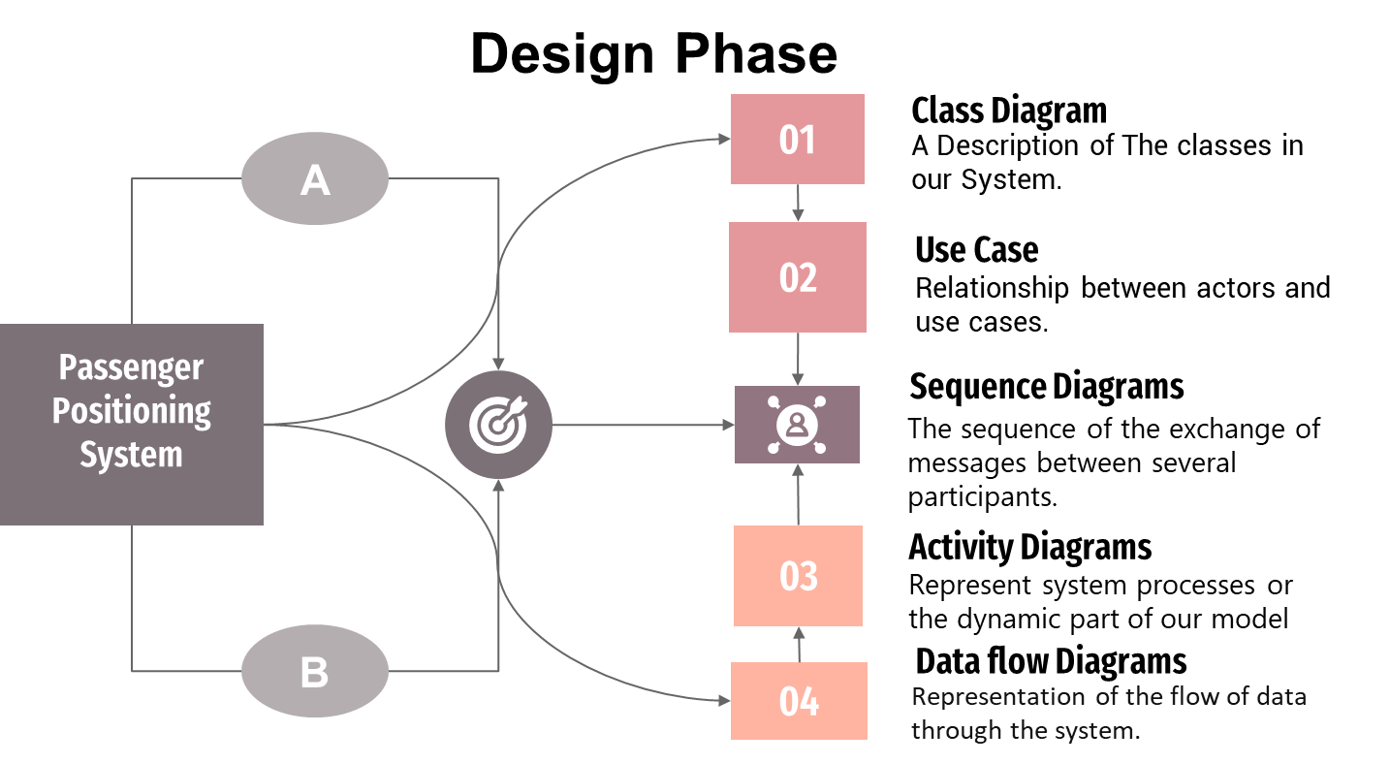

Slide 3

Class Diagrams
Class diagram are illustrations of the relationships and source code dependencies among classes in the Unified Modeling Language (UML).

Slide 4
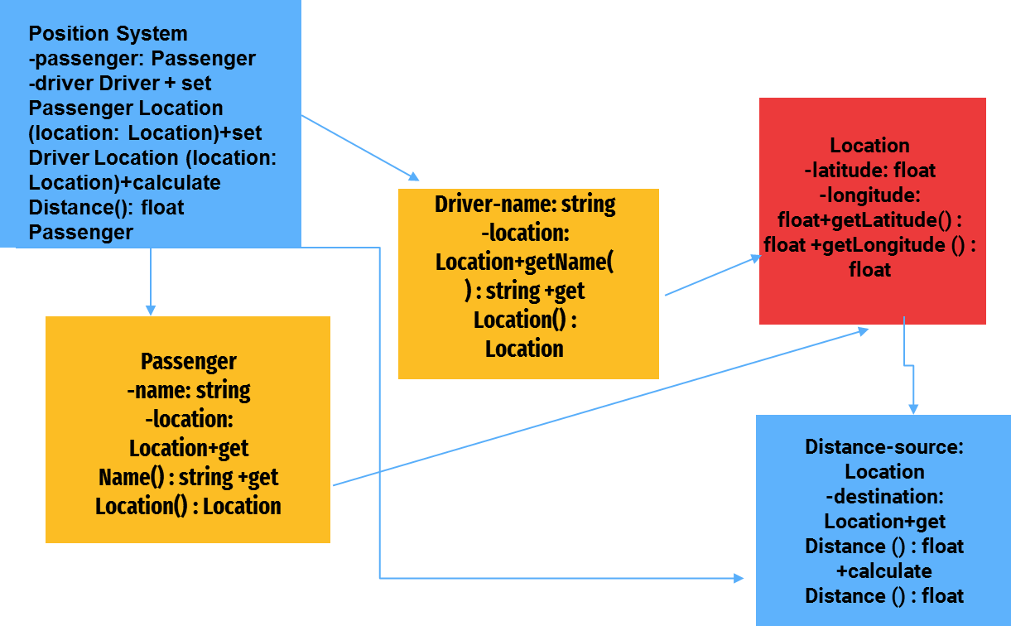
Class Diagram

Slide 5

Use-Case
Diagrams
A use case diagram is a graphical depiction of a user's possible interactions with a system. A use case diagram shows various use cases and different types of users the system has and will often be accompanied by other types of diagrams as well.

Slide 6
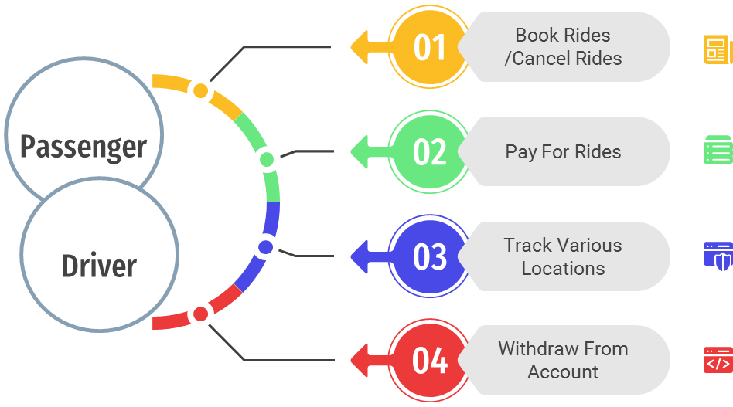
Use-Case Diagrams

Slide 7


Slide 8
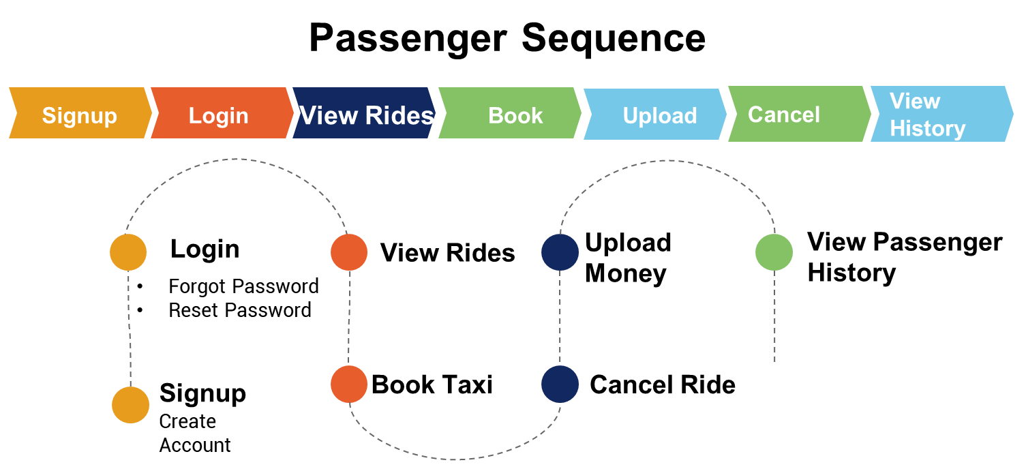

Slide 9
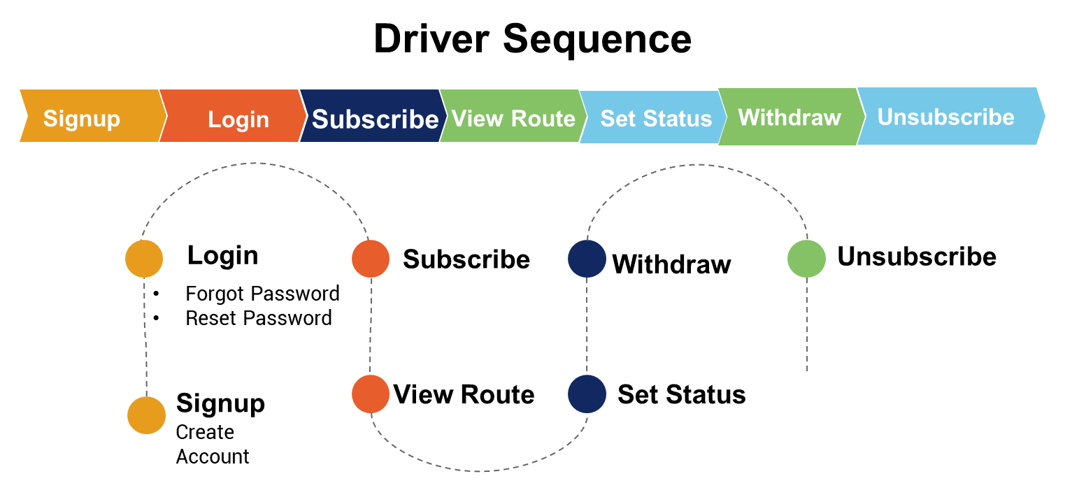

Slide 10
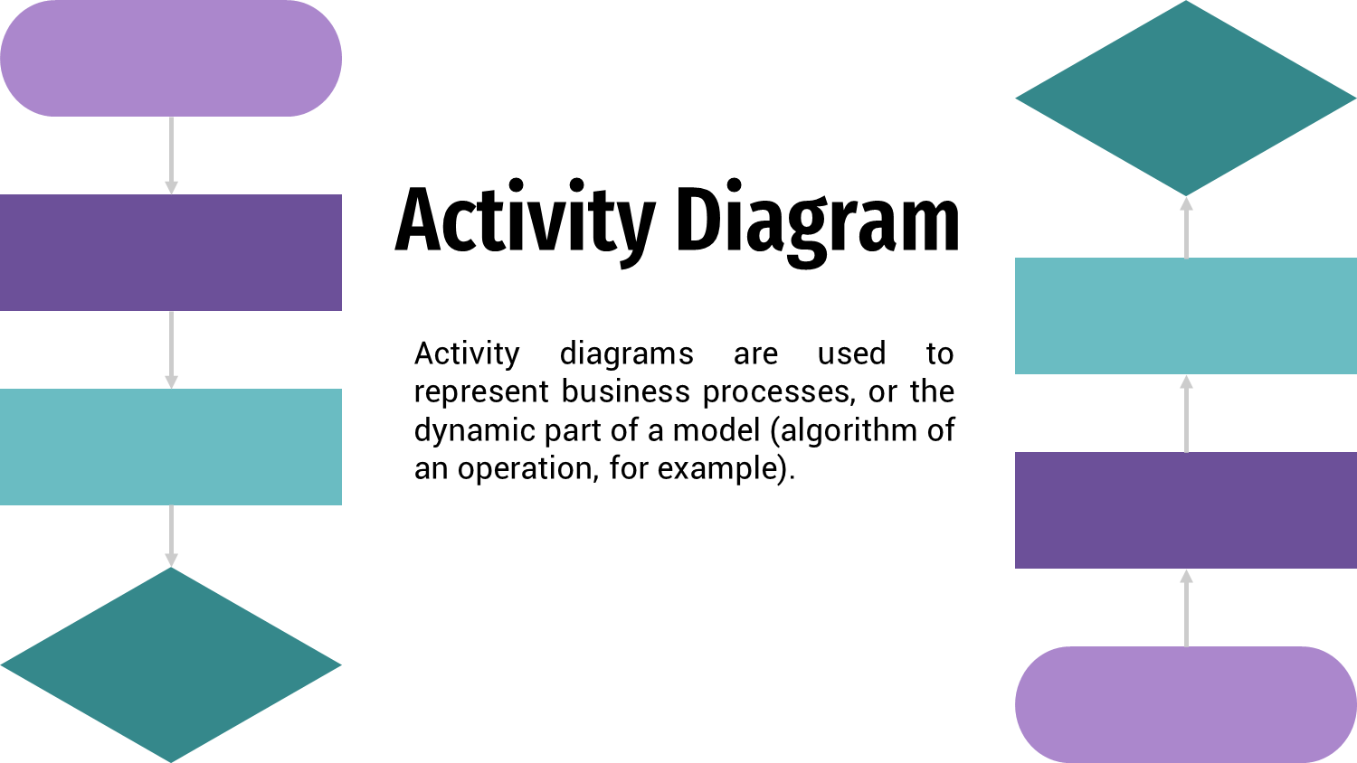

Slide 11
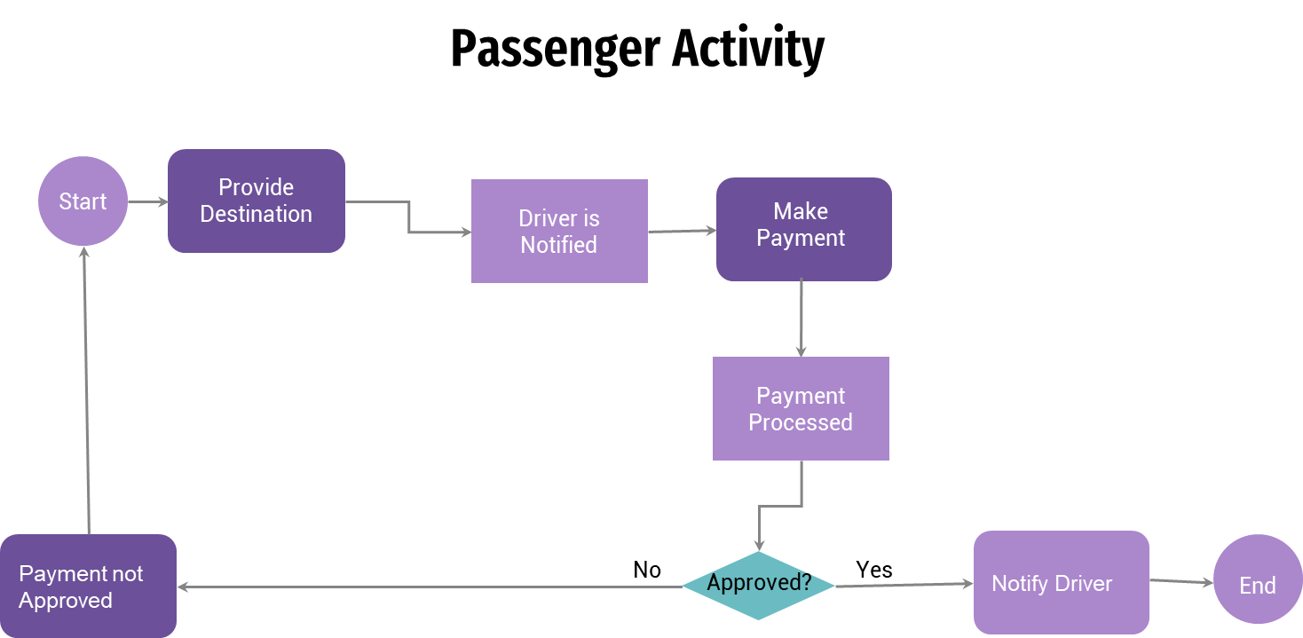

Slide 12
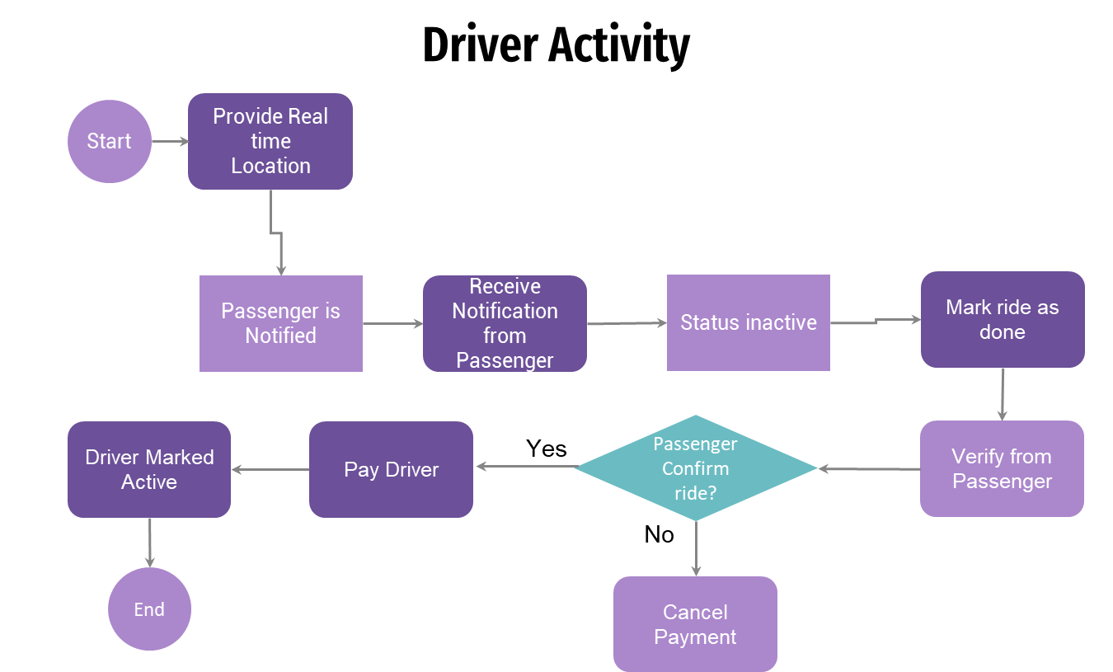

Slide 13
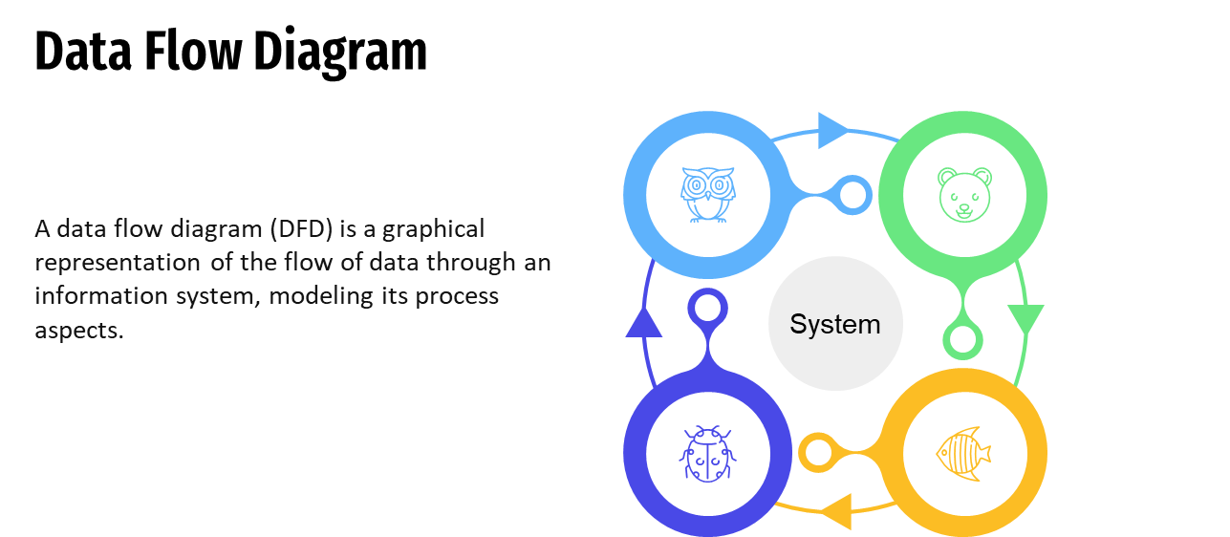

Slide 14
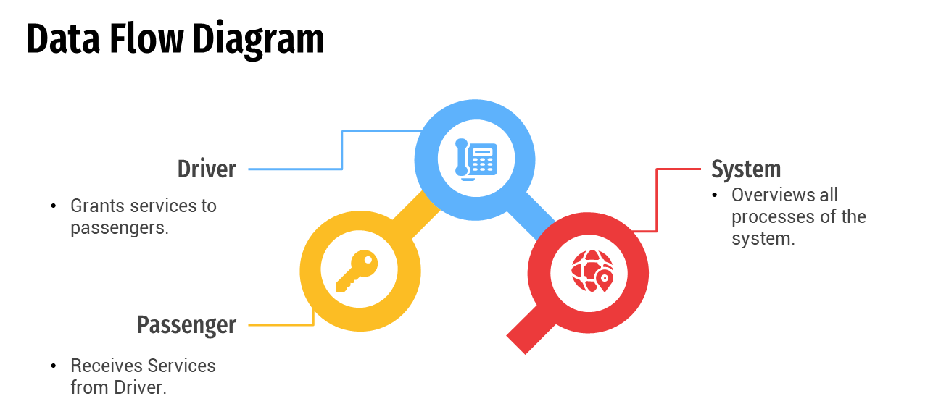

Slide 15


